Slide 1
US Army RDECOM
(Robotic Vehicle System)
Sean Ramocki, Eric Ramocki, Anton Cataldo, Scott Dudley,
Alex Alwardt, Christian Nickolaou, Hassan Abdullah

Slide 2
Application Goal (Vision Statement)
On the modern battlefield, the ability to deploy troops on the ground in a fast and efficient manner is important to ensuring your side has the tactical advantage.
Delivery to specific location
Collision Detection/Avoidance
Obstructions
Loss-Of-Sight

Slide 3
Application Features
Remote controlled leader RC vehicle
Piloted with Gamepad
Autonomous follower vehicle
Shares navigational data with the leader and application
Obstruction handling
Collision prevention with leader
Line-of-sight position translations

Slide 4
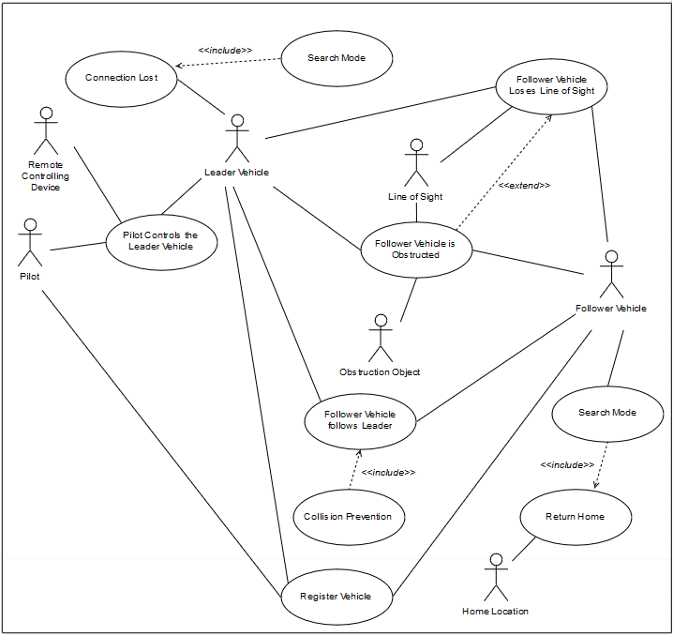
Use Case Diagram

Slide 5
Project Plan by Sprint
Sprint #1
Project Plan, Requirements, Tool Chain Setup, Project Scope Capture
Sprint #2
Diagrams, Register Vehicle, Connection Lost, Pilot Drives Lead Vehicle
Sprint #3
Follower Vehicle Follows Leader, Collision Detection/Prevention
Sprint #4
Blocked Follower, Follower Vehicle Loses Line-of-Sight

Slide 6
Project Plan by Sprint
Sprint #5
Search Mode
Sprint #6
Return Home Mode
Sprint #7
Testing, Bug Fixes, Dry Run
Sprint #8
Testing, Bug Fixes, Final Competition

Slide 7
Tools used
Github
Slack
Google Docs

Slide 8
Potential Technology
VEX/RobotC
Matlab Image Processing/Computer Vision
Raspberry Pi, Camera and OpenCV

